Slide 1

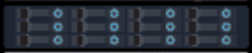
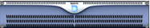
20–120 TB
Mgmt switch
Data switches
13U
UPS
UPS
Data nodes
UPS

Slide 2
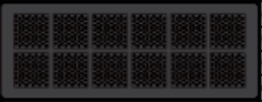
20–120 TB
ML & AI
Mgmt switch
Data switches
App nodes
13U
UPS
UPS
Data nodes
UPS
Network
switches

